Slide 1
Introduction to R Workshop
Amrom Obstfeld
July 15, 2021
Notes:
Hello everyone and welcome to this years Introducton to R workshop. I am Amrom Obstfeld the organizer of the course representing the presenters. We are so excited you have made the decision to take the time to join us and learn about R and how it can be used to power reproducible high quality data analysis and data science.
This workshop is designed for beginners who are brand new to R and new to coding in general. If you have some experience we're here to help you build up some R muscle memory, in addition to completely newbs we often see those looking for a refresher come back to take the workshop again, so welcome all.

Slide 2
Course Introduction
Notes:
I'm here just to give you a quick introduction after which we'll dive right into the meat of the workshop.

Slide 3
Goals and Objectives
Advocate for the use of R as a means of improving reproducibility in clinical data analysis
Demonstrate how R is used to perform analyses of laboratory operational data
Establish a basis of understanding in the 'tidy' approach to data analysis within the framework of R
Notes:
Obviously we would love for those who are here today to all walk away and just start coding but the reality is that while that would be great we also have a set of more modest if more important goals
We're here to Advocate for the use of R as a means of improving reproducibility in clinical data analysis and I cannot emphasize enough how strongly we feel about this point
As we review this we will demonstrate how we can use R perform analyses of laboratory operational data
And we also hope to establish a baseline understanding of what tidy data is and how to implement a 'tidy' approach to data analysis within the framework of R

Slide 4
July 15, 2021 | Session | Instructor
1:00 pm - 1:30 pm | Instructor Introductions, Introduction to technology | Amrom Obstfeld
1:35 pm - 2:05 pm | Introduction to R and RStudio | Joe Rudolf
2:20 pm - 3:15 pm | Reproducible Reporting | Joe Rudolf
3:30 pm - 5:00 pm | Data Visualization | Stephan Kadauke
July 16, 2021
1:00 pm - 2:30 pm | Data Transformation | Amrom Obstfeld
2:45 pm - 4:15 pm | Statistical Analysis | Dan Herman
4:30 pm - 5:00 pm | Advanced Reporting | Patrick Mathias

Slide 5
Who are we?

Slide 6
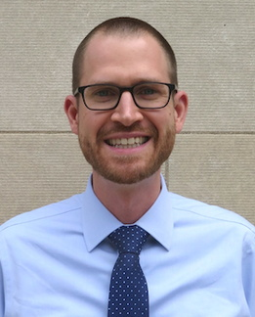
Joseph Rudolf
Assistant Professor, Department of Pathology, University of Utah Medical School
Medical Director, Automated Core Laboratory, ARUP Laboratories
Notes:
Joseph Rudolf, MD is the medical director for the automated core laboratory at ARUP Laboratories in Salt Lake City, Utah. His clinical and research interests focus on the intersection of informatics and clinical operations including clinical decision support, utilization management, and reporting and analytics. He is also passionate about clinical process improvement and initiatives to support quality and safety.

Slide 7
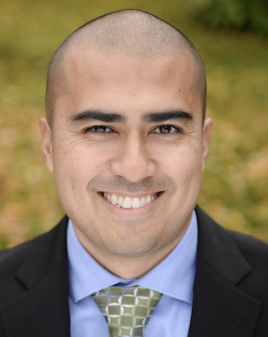
Patrick Mathias
Assistant Professor, Department of Laboratory Medicine and Pathology
University of Washington School of Medicine
Associate Medical Director, Laboratory Medicine and Pathology Informatics
Notes:
Patrick Mathias, MD, PhD, is the Associate Medical Director of the Informatics Division in the Department of Laboratory Medicine at the University of Washington School of Medicine. His interests include developing data science and analytics as a core competency to improve clinical lab operations and laboratory stewardship, and applying clinical informatics approaches to mitigate laboratory-associated diagnostic errors. He is interested in developing and improving programming and data science education across all levels of pathology practice.

Slide 8
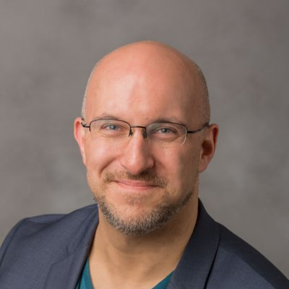
Stephan Kadauke
Assistant Professor of Clinical Pathology and Laboratory Medicine
University of Pennsylvania Perelman School of Medicine
Assistant Director of the Cell and Gene Therapy Laboratory
Children's Hospital of Philadelphia
Notes:
Stephan Kadauke, MD, PhD is an Assistant Professor of Pathology and Lab Medicine at the Children’s Hospital of Philadelphia where he is the Assistant Director of the Cell and Gene Therapy Lab. He leads the Cell and Gene Therapy DataOps group which builds and deploys predictive models and other data products for the care of children who receive bone marrow transplants and other cell therapies.

Slide 9
Daniel Herman
Assistant Professor of Pathology and Laboratory Medicine
University of Pennsylvania Perelman School of Medicine
Director, Endocrinology Laboratory
Hospital of the University of Pennsylvania
Notes:
Daniel Herman practices clinical pathology at the University of Pennsylvania, where he directs the Endocrinology laboratory. His current clinical practice, in addition to clinical chemistry, includes leading informatics projects to make better use of existing laboratory data in the form of live operational dashboards, test utilization reports, and identification of missing patient diagnoses.
His research group has been developing EHR-based methods to improve population health screening, focused recently on improving population hypertension management by identifying patients with undiagnosed primary aldosteronism. He is also interested in the intersection of pathology and policy and currently serves as College of American Pathology State Issue Advisor for Pennsylvania.

Slide 10
Amrom Obstfeld
Assistant Professor of Clinical Pathology and Laboratory Medicine
University of Pennsylvania Perelman School of Medicine
Director of Pathology Informatics
Children's Hospital of Philadelphia
Notes:
And this is me, Amrom Obstfeld MD, PhD, I am the Medical Director of the Division of Pathology Informatics at Children’s Hospital of Philadelphia. In this role I lead the development of analytic tools to aid in quality management and operations, interfaces with other groups throughout the hospital on informatics initiatives and I also in design and implement informatics educational experiences for pathology trainees and faculty at the University of Pennsylvania.

Slide 11
Workshop Workflow
Notes:
So now that you've met us let's discuss for a moment how this workshop is going to work

Slide 12
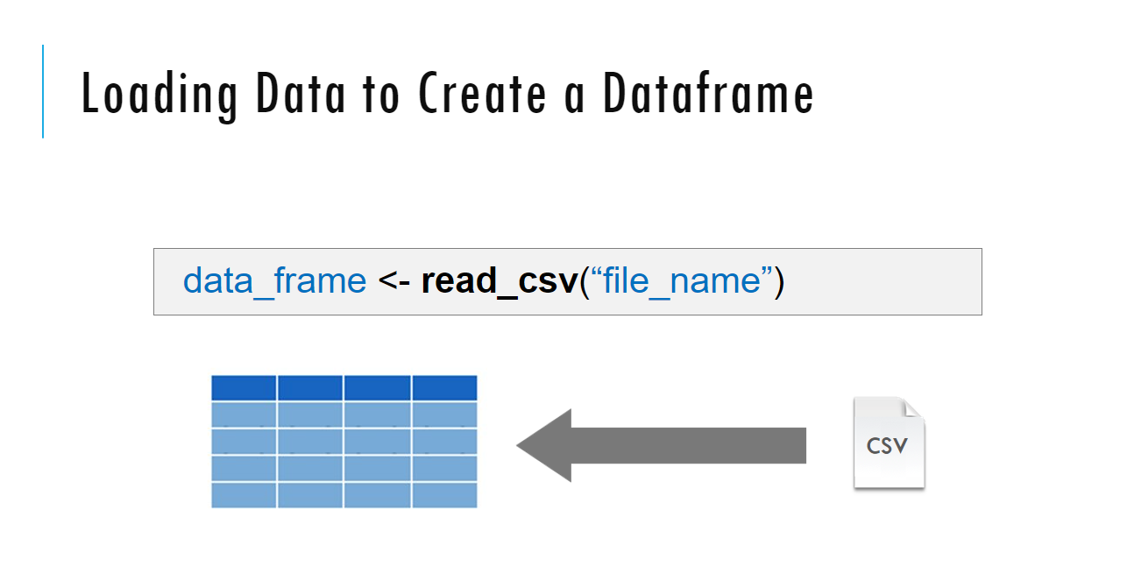
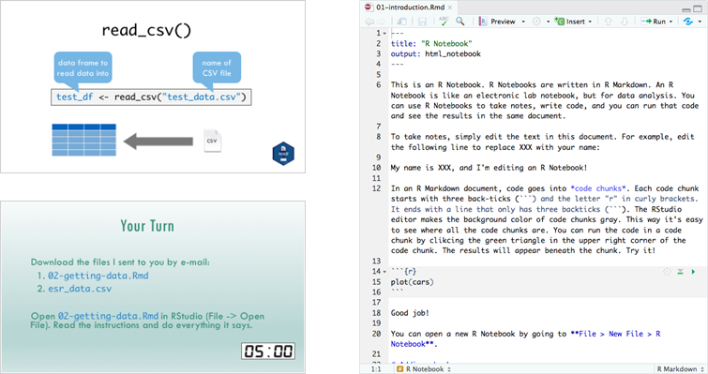
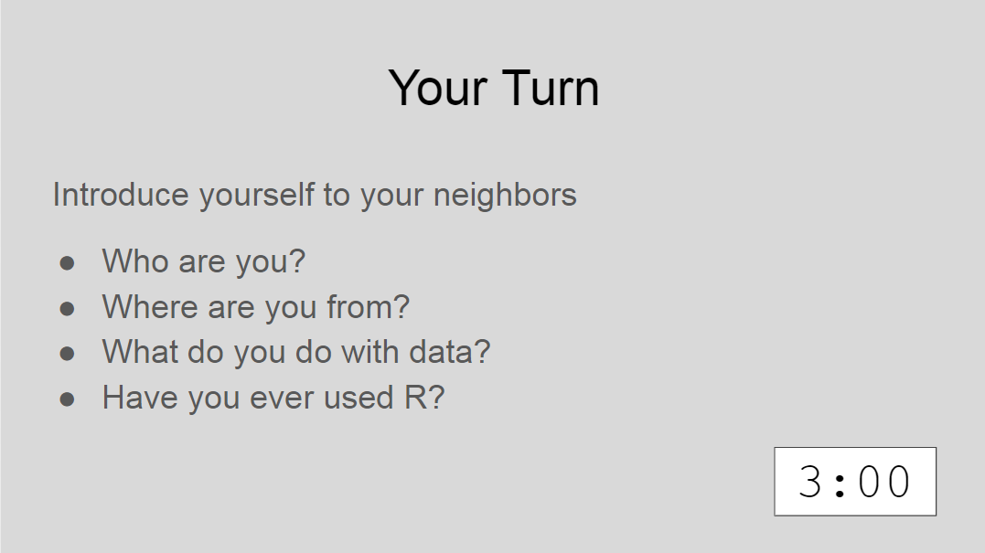
Sessions
Notes:
The meat of the workshop are the sessions each of which will cover discrete subjects or components of R in a data analysis. The sessions have a powerpoint associated with it as well as an R script.
We'll be describing a specific function or topic in the context of the powerpoint – all of which are included in the coursebook and available for download. The same code that is being demoed is included in the R script and you are invited to follow along, run the code, play with it if you like.
At several points in the session we'll have you engage in some exercises which we call Your Turns. In a Your Turn we'll assess how we're doing by asking you to critically think about the topic in the session and respond to a question or do some coding on your own. We'll speak a bit later about how these coding exercises will work.

Slide 13

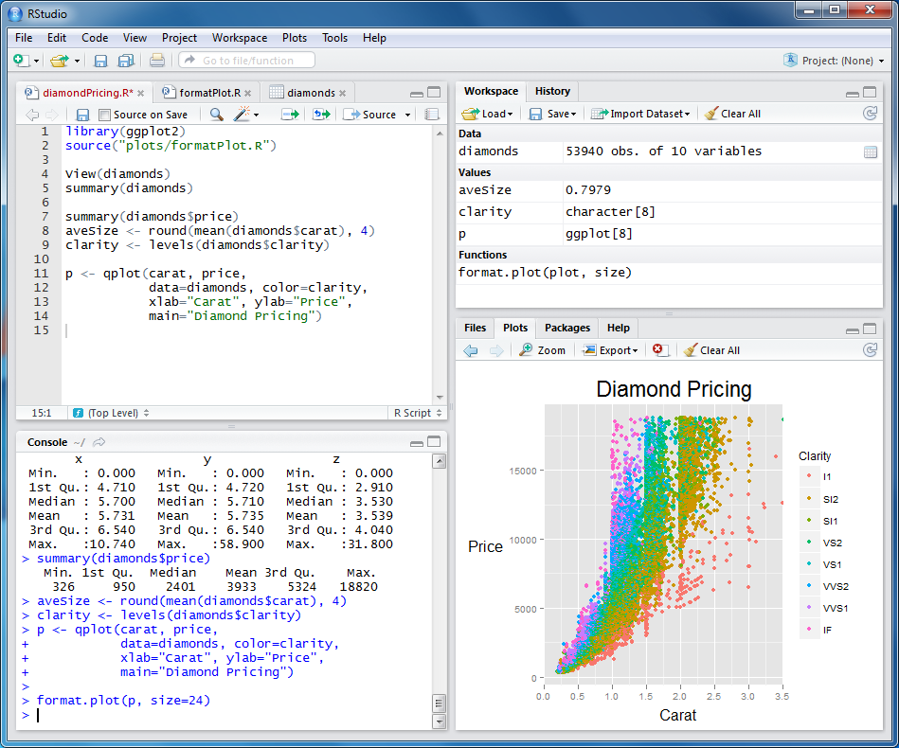
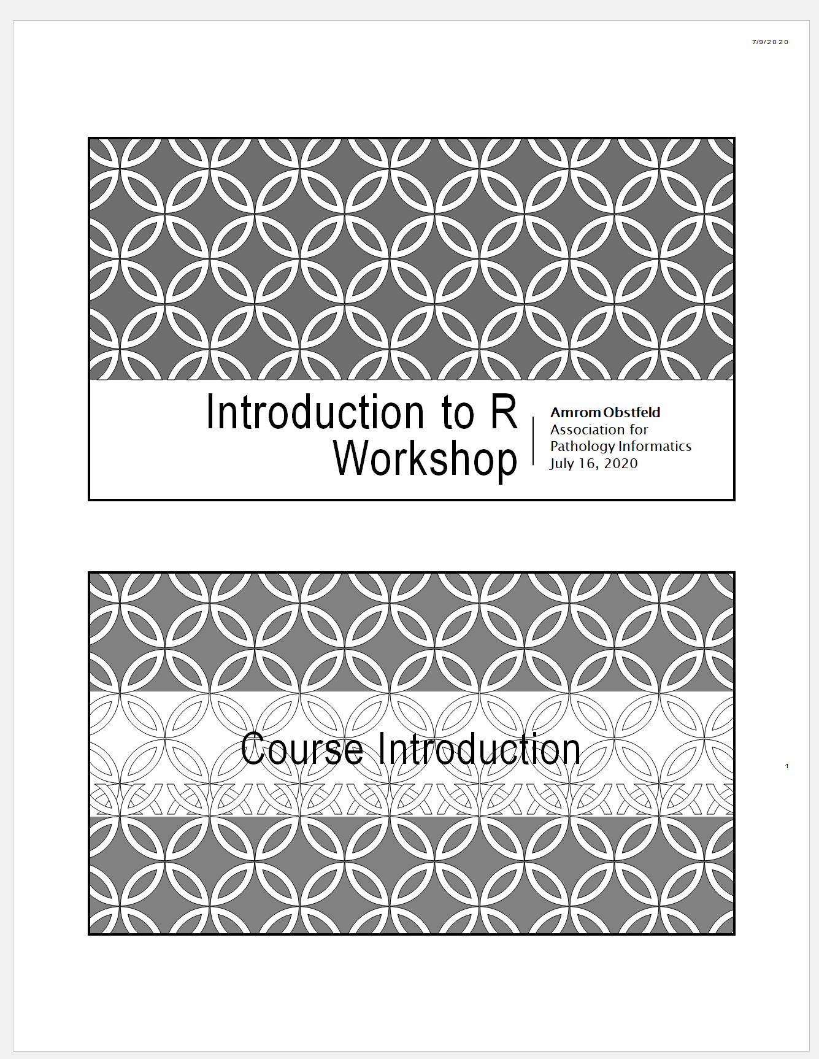
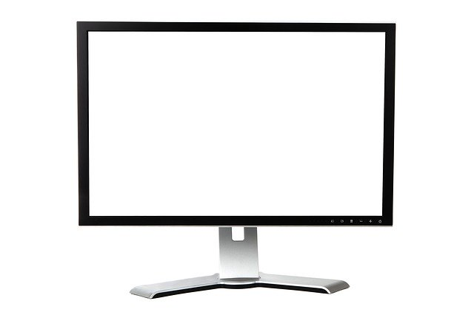

Your Setup
1
2
Notes:
These are the resources that you should have access to during this workshop.
Ideally you have zoom open on one of your monitors, you have a second monitor in which you will be opening up the Rstudio cloud application, we haven’t gotten to that yet so don’t worry about that yet
And third you should have the PDF of the course book available to you at your desk.
We of course understand that not everyone has two monitors, not anyone has the capacity to print out a few hundred pages of the course book, so if you have a tablet and can use Zoom on it, we encourage you to open up the zoom there and at least have the PDF of the course book open on your computer as well.

Slide 14
Workshop Coursebook
Print out of all slides
Appendix
Cheat sheets
Useful resources
Notes:
The coursebook has all the session powerpoints as well as an appendix that has some additional resources
Cheat sheets are concise one or two page documents that you can use as a quick reference. we'll be referring to these during the sessions. They are also easily googlable and available through the help menu in Rstudio. There is also a one page Useful resources document with links to free online resources like textbooks, videos and courses.

Slide 15
Using Zoom
Participants muted
Chat window
Non-verbal feedback
Breakout sessions
Notes:
Let’s talk a little bit about how we'll be using zoom in this workshop.
During the sessions everyone will be muted other than the instructor. We just want to be make sure we don’t get accidental background noise. But that doesn’t mean that there won’t be opportunities for engagement, we want to make sure that this is an interactive workshop and not a one way street when it comes to interaction.
We will be using the chat window in Zoom we will also be using some nonverbal feedback modalities and we'll be using some breakout sessions during which we'll be doing exercises together in an interactive way, more about all this in a few moments.

Slide 16
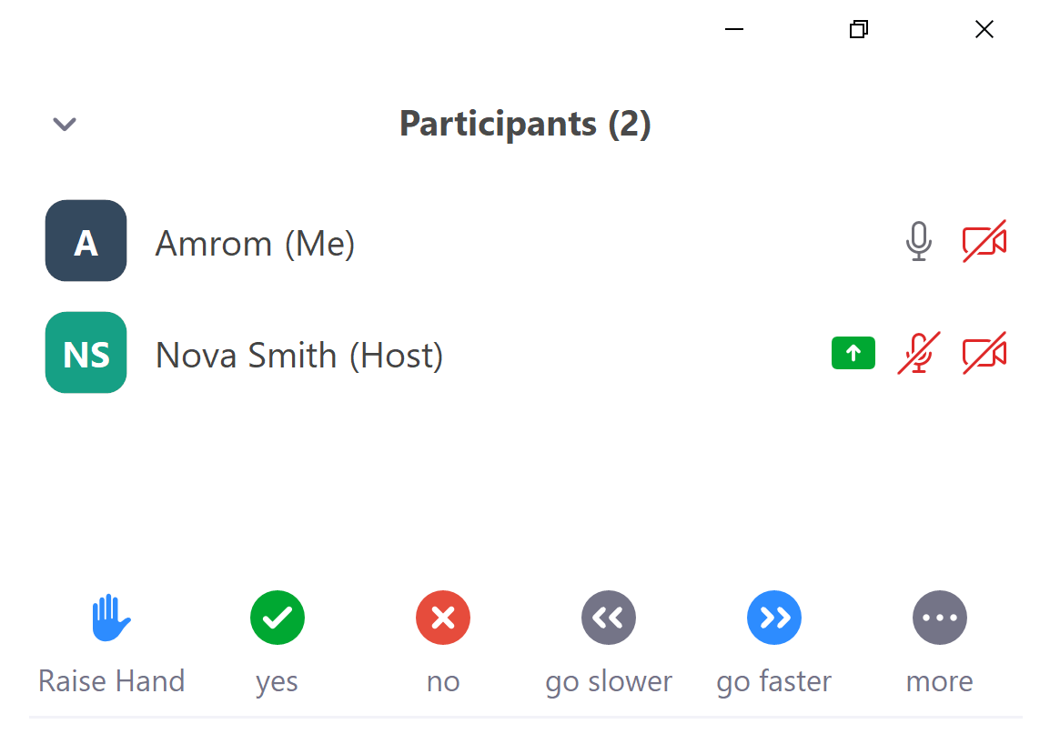
Getting Help
Simple question – Chat window
More complicated - Raise hand, instructor will message
Really complicated – Breakout session
Notes:
During the workshop sooner or later you’re going to need some help.
If you find yourself having a question or needing assistance during a presentation you have a few options.
If its pretty simple or as an initial pass you can drop it in the chat window.
You're also welcome to click the raise your hand icon and an instructor will send you a message and at that point you can try to work through the issue together and if need be you can jump into a breakout room with an instructor to get more intense help
There may be issues that are just too challenging to handle in the context of a virtual workshop. If that does occur we’re going to ask you to make a note of the issue, try to keep with the workshop, and hopefully we can find a way to take it off line.

Slide 17
Who are you?
Notes:
So, now that you've learned a bit about us and how this is all going to work, let's find out a little bit about you

Slide 18

Your Turn
Introduce yourself to your breakout roommates
Who are you?
Where are you from?
Why are you here?
Have you ever used R?
Notes:
For our first Your Turn Nova will send us all into breakout rooms. You may need to manually click the join break out room button. Once you're there feel free to share who you are, where you are in training or what your position is in your organization, and what you hope to get out of this course.
After a few minutes Nova will call us back together and we'll finish up this intro session.

Slide 19
Final Tips
The best way to learn to code is by doing
Practice is key!
Notes:
And just some final words before we begin, no matter what you're learning but particularly coding, the best way to learn is by doing:
Find a project, make a goal for yourself, push yourself to use R, it's OK to lean on some excel, we all do when we're starting out, but try to get that activation energy to get your hands typing code. We would not be teaching this course if we didn't strongly believe that R is accessible to all of you. So keep practicing and you'll get there.
With that let's get started with the workshop. Up next Joe will provide us with the basics of R and get us up and running with Rstudio Cloud.

